Slide 1
Enhanced Network Attack Detection Using
TCN–BiLSTM–Transformer Framework
Duggempudi Anji Reddy (22471A1262)
Dasari Sri Saran (22471A1212)
Mekala Karthik (22471A1229)

Slide 2
Problem Statement
Rapid growth of cyberattacks in modern networks
Traditional IDS fail to detect:
Complex attacks
Low-frequency attacks
Challenges:
Imbalanced datasets
High-dimensional data
Dynamic traffic patterns
Need for an intelligent and adaptive intrusion detection system

Slide 3
Objectives
Develop an advanced intrusion detection model
Combine:
TCN (Temporal patterns)
BiLSTM (Sequential learning)
Transformer (Global dependencies)
Improve:
Accuracy
Precision
F1-score
Detect both common and rare attacks effectively

Slide 4
Dataset Description
Datasets used:
NSL-KDD
UNSW-NB15
Contains:
Normal and attack traffic
Features include:
Network behavior
Protocol information
Data split:
80% Training
20% Testing

Slide 5
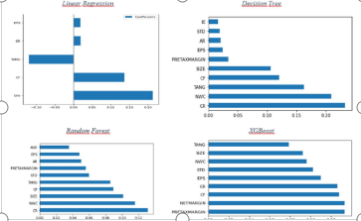
Data Preprocessing
Missing value handling using mode imputation.
Handling missing values
Normalization using Min-Max scaling
Categorical encoding:
One-Hot Encoding
Feature selection:
BRFE (Boosted Recursive Feature Elimination)
Class imbalance handled using:
SMOTE

Slide 6
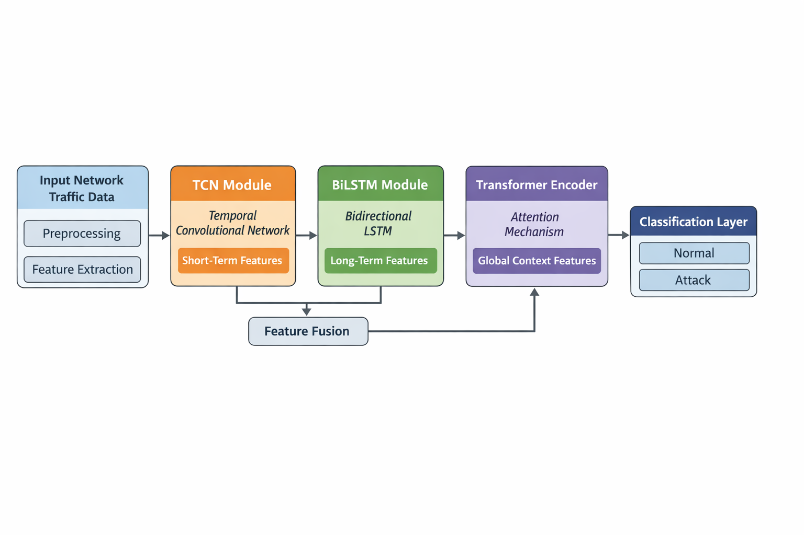
Model Architecture
The system processes network traffic through preprocessing and feature extraction to prepare clean and structured input data
TCN and BiLSTM modules capture both short-term and long-term temporal patterns in network behavior
Feature fusion combines outputs from multiple models to improve representation and learning capability.Transformer encoder applies attention mechanism to capture global dependencies, leading to accurate classification of normal and attack traffic.

Slide 7
Training & Optimization
Optimizer: Adam
Learning rate: 0.001
Techniques used:
Dropout (prevent overfitting)
Early stopping
Validation monitoring
Balanced learning using SMOTE

Slide 8
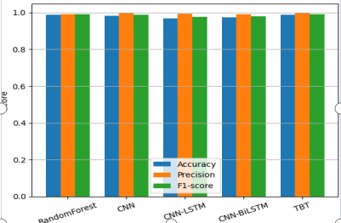
The graph compares the performance of multiple models (Random Forest, CNN, CNN-LSTM, CNN-BiLSTM, and TBT) using Accuracy, Precision, and F1-score metrics.
The proposed TBT model achieves the highest overall performance, with values very close to 1.0 across all evaluation metrics.
Performance Results

Slide 9
Ablation Study & Error Analysis
Ablation Study Findings:
Without TCN → 94.2% accuracy
Without BiLSTM → 95.1% accuracy
Without Transformer → 95.8% accuracy
Without Attention → 96.3% accuracy
Error Analysis:
Misclassification occurs mainly due to similar patterns between normal and attack traffic
Rare and low-frequency attacks are often incorrectly predicted due to limited samples
Class imbalance and feature overlap reduce the model’s ability to generalize effectively

Slide 10
Conclusion & Future Work
Conclusion
The proposed TCN–BiLSTM–Transformer model significantly improves intrusion detection accuracy and reliability.
It effectively captures temporal and global patterns, enabling detection of both common and rare cyberattacks.
Future Work
Extend to multi-class classification (DoS, Probe, R2L, U2R)
Implement federated learning for privacy-preserving IDS
Optimize model for edge devices (IoT, routers)
Integrate real-time traffic monitoring systems

Slide 11


